Slide 1
Network Lan technologies
Prepared by
Nidhi Sharma

Slide 2
Content
Introduction
Ethernet
Types of Ethernet
Data Link Protocols

Slide 3
Introduction
LAN stands for Local Area Network.
A LAN is a computer network that covers a small area, like a single building or a campus (up to a few kilometers).
Purpose: LANs are commonly used to connect devices (like personal computers and workstations) within a company or home.
Real-life example: A family is a good analogy for a LAN, where each family member (device) is connected to each other.

Slide 4
Ethernet
Ethernet is the most widely used LAN technology, defined by IEEE 802.3 standards.
Reasons for popularity: It's easy to understand, implement, and maintain, allowing for low-cost network setup.
OSI Model Layers: Ethernet operates at the Physical Layer and Data Link Layer of the OSI model.
Data Unit: Its protocol data unit is a frame.

Slide 5
Types of ethernet
Fast Ethernet
Gigabit Ethernet
10-Gigabit Ethernet
Switch Ethernet

Slide 6
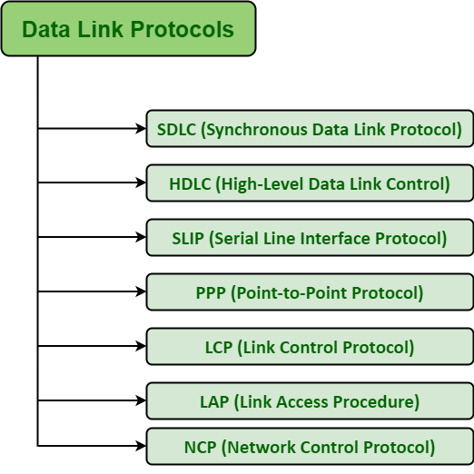
Data link protocols

Slide 7
Thank You

